Slide 1
This is an old version of the toolkit. Please see latest version here

Slide 2


TP Technology & Transformation Toolkit
For internal use
Updated: October 2023

Slide 3
Contents
Introduction┃Contents┃Business Development┃Propose┃Deliver┃Other
Business Development
Click the area of the Toolkit you would like to explore.
Targeting
Opportunity Tracking
Financial Insights
Tax Opportunities Portal
Create a Proposal
Demo a Tool
Price a Project
Other
Propose
Disputes
Strategy & Policy Setting
Implementation
Documentation
Deliver

Slide 4
Contents
Introduction┃Contents┃Business Development┃Propose┃Deliver┃Other
Click the area of the Toolkit you would like to explore.
Tools focussing on delivering client work
Tools focussing on other aspects of our jobs
Other
Propose

Slide 5

Introduction
Introduction┃Contents┃Business Development┃Propose┃Deliver┃Other
Your navigation bar, hyperlinked to take you to your desired area of the Toolkit
 | The Challenge As a network, we have developed numerous digital assets and resources which help us target, propose and deliver Transfer Pricing services to our clients. However, these digital assets and resources (before now) have been located in varying depositories with restrictive access. This often means that the adoption of these assets is significantly lower than what it could be.
 | Our Solution The TP Technology & Transformation Toolkit.
 | Purpose Centralise useful information pertaining to each digital asset and resource Create shortcuts to links to the digital assets and resources, ergo increase accessibility and adoption Maintain an easy to use format
 | Pricing Free
 | Contact james.andrews@pwc.com jack.korny@pwc.com james.schaefer@pwc.com |  | Important links Example link 1 Example link 2 Example link 3
Feature 1
Link to the digital asset and pertinent information
Feature 2
Digital asset area of application
The internal UK TP Tech team responsible for the digital asset
Feature 3
Key features of the digital asset
Business development
Delivery (advisory)
Delivery (Operational TP)
Delivery (Compliance)
Delivery (disputes)
Admin
Internal
IE&E

Slide 6
TP-specific tools

Slide 7
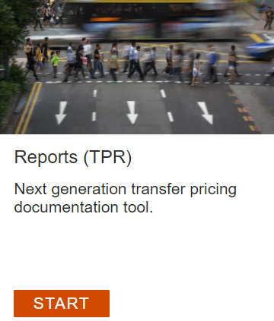
TP Reporting Suite
Introduction┃Contents┃Business Development┃Propose┃Deliver┃Other
 | The Challenge Delivering large documentation projects in a tech enabled way.
 | Our Solution TP Reports is PwC’s shared web-based platform to make preparing TP documentation efficient, accurate, and scalable
 | Key tool features Reports - web-based platform for preparing Master File and individual TP reports, including powerful modules for you and PwC teams to share information and review and edit reports Data collection (DCT) - create custom Excel collection files to work with Engagement Centre / R&Q / Email for consolidating client responses Data Hub Importer (TPDHi) - importing client ERP and Transactional data into a flexible data model for analysis. Data Hub Vizualiser (TPDHV) - Visualise your imported client data from the Data Hub Importer.
 | Contact david.oak@pwc.com hannah.l.owen@pwc.com caoilin.kearns@pwc.com fernando.lopez@pwc.com |  | Important links Marketing slides Guidance on preparing reports and connecting TPI data Beta TP Reports tool Training site Data Hub Visualizer (TPDHv) tool Data Collection Tool Data Hub Importer (TPDHi) tool
Business development
Delivery (advisory)
Delivery (Operational TP)
Delivery (Compliance)
Delivery (Compliance)
Delivery (disputes)
Admin
Client facing
Internal

Slide 8
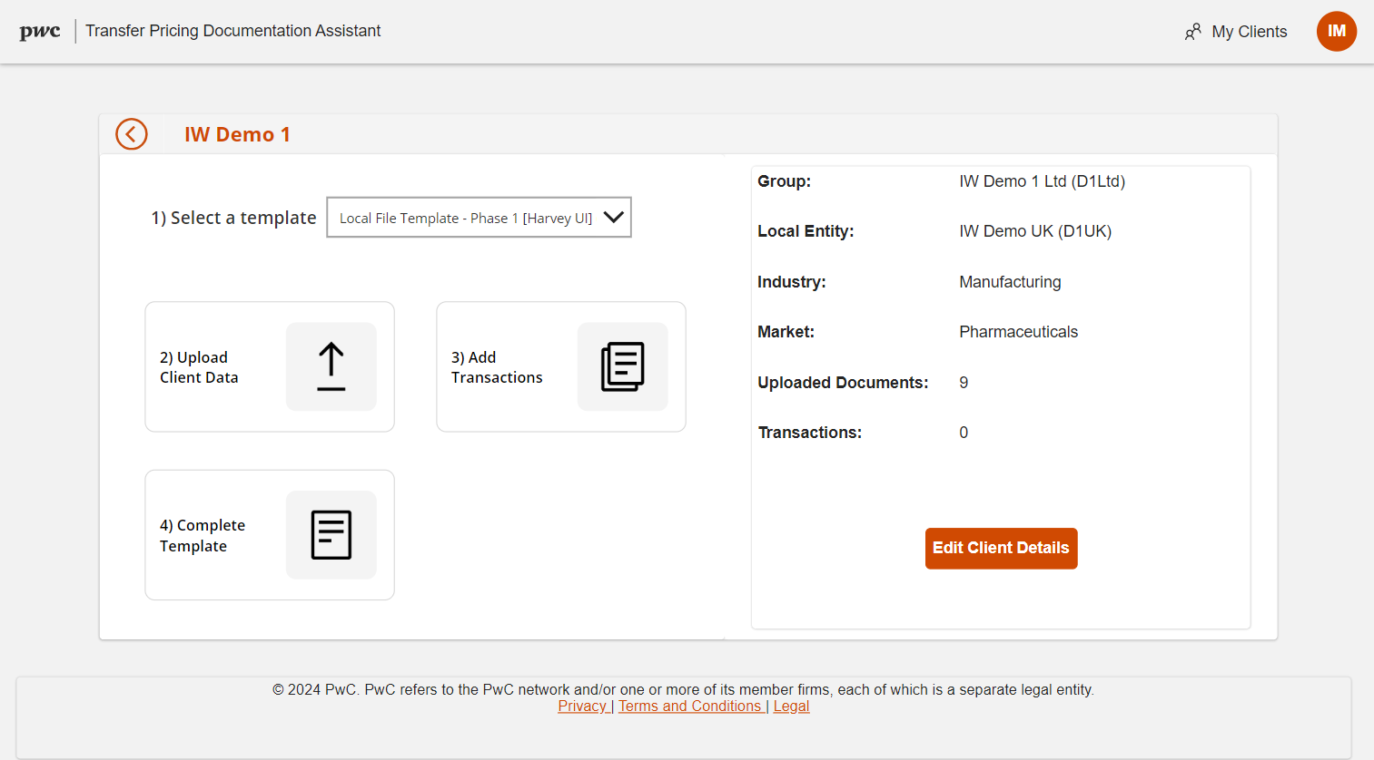
TPDA (Transfer Pricing Documentation Assistant)
Introduction┃Contents┃Business Development┃Propose┃Deliver┃Other
 | The Challenge Preparing TP documentation efficiently making the most of the available data sources.
 | Our Solution TPDA is is an AI based platform used to generate TP documentation based on client data.
 | Key tool features TP documentation templates Pre-defined dynamic prompt library Automated report generation
 | Contact ignas.matevicius@pwc.com james.andrews@pwc.com |  | Important links TPDA access [coming soon] User tutorial
Delivery (Compliance)
Internal

Slide 9
TNMM (Transactional Net Margin Method)
Introduction┃Contents┃Business Development┃Propose┃Deliver┃Other
 | The Challenge
 | Our Solution
 | Key tool features
 | Contact |  | Important links
Delivery (Compliance)
Internal

Slide 10
FTTP (Financial Transactions Transfer Pricing)
Introduction┃Contents┃Business Development┃Propose┃Deliver┃Other
 | The Challenge Efficient and consistent benchmarking for financial transactions.
 | Our Solution FTTP is a web based platform for benchmarking financial transactions.
 | Key tool features Automated interest rate analysis Automated debt capacity analysis Automated guarantee pricing analysis Find searches performed by anyone in the network Alteryx integration
 | Contact izeth.jameel@pwc.com |  | Important links Tool access Supporting materials
Delivery (advisory)
Delivery (Compliance)
Delivery (disputes)
Internal

Slide 11
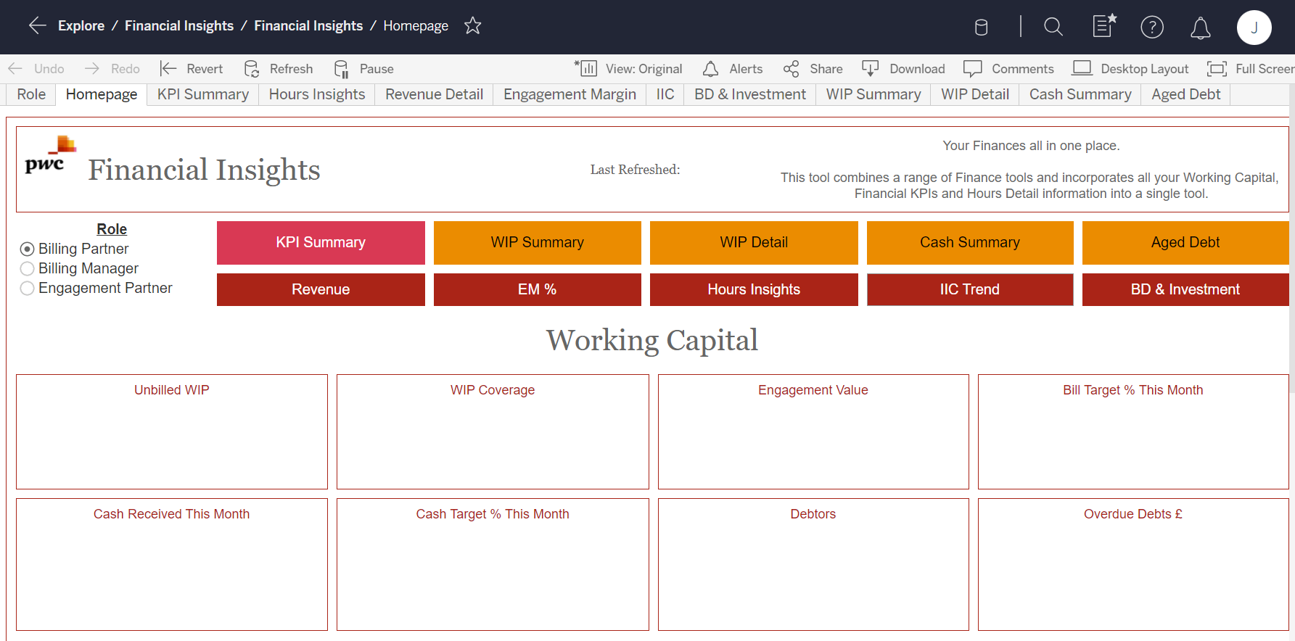
FTTP Insights
Introduction┃Contents┃Business Development┃Propose┃Deliver┃Other
 | The Challenge
 | Our Solution
 | Key tool features
 | Contact |  | Important links
Business development
Delivery (advisory)
Delivery (Operational TP)
Delivery (Compliance)
Delivery (disputes)
Admin
Internal

Slide 12
TP Essentials
Introduction┃Contents┃Business Development┃Propose┃Deliver┃Other
 | The Challenge
 | Our Solution
 | Key tool features
 | Contact |  | Important links
Business development
Delivery (Compliance)
Internal

Slide 13
CUT
Introduction┃Contents┃Business Development┃Propose┃Deliver┃Other
 | The Challenge
 | Our Solution
 | Key tool features
 | Contact |  | Important links
Delivery (advisory)
Delivery (Compliance)
Internal

Slide 14
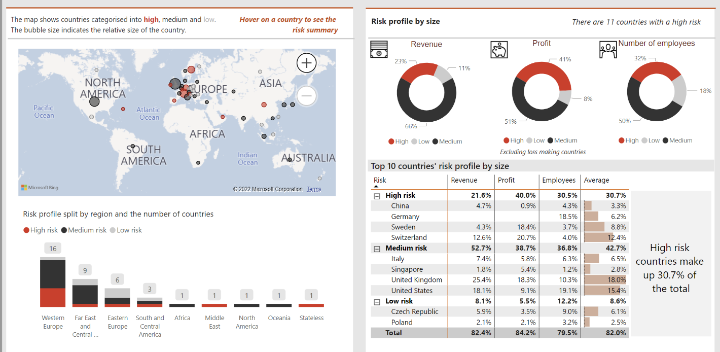
Risk Profiling Tool
Introduction┃Contents┃Business Development┃Propose┃Deliver┃Other
 | The Challenge Helping clients identify areas of potential challenge by tax authorities in their operating models.
 | Our Solution The Risk Profiling Tool (“RPT”) takes data (both from client’s CbCR, where available, as well as public data sources) to produce powerful visualisations and allow you to identify likely areas of focus by HMRC. ⇒ take a looksy
 | Application & Industry For Our Solution As part of a regular review of TP documentation. Taking a preliminary look at the types of data that may be included in the proposed Summary Audit Trail, to identify potential areas HMRC may perceive as risky. In preparation for a Business Risk Review. As an add-on to a review for the Audit of Tax. When addressing Tax aspects of Deals (such as bidder support, when assessing risks of a potential target, or as part of a pre-sale clean up or VDD prep).
 | Pricing In terms of how much it will cost you = No fixed fee and say 2x hours of Dani Cucca’s time to set up In terms of how much to charge your client = That is up to you, but speak to Scott, Martin or Frances if you have questions.
 | Contact scott.bundy@pwc.com, martin.s.kennedy@pwc.com, frances.clapham@pwc.com, |  | Important links Link to interactive demo Link to client flyer 1 Link to client flyer 2 Link to auto generated client email
Business development
Delivery (advisory)
Client facing

Slide 15
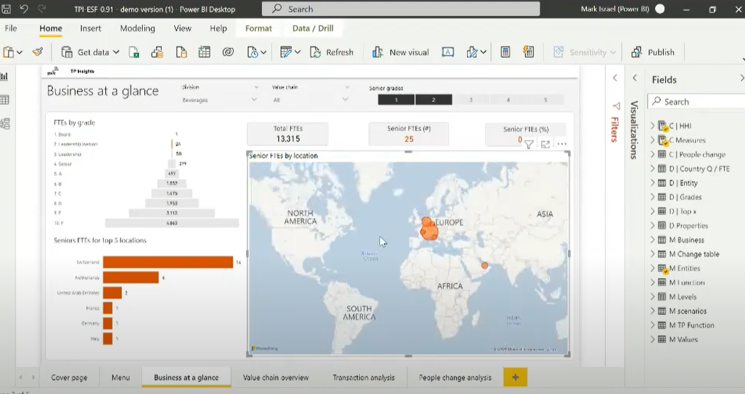
Economically significant functions tool
Introduction┃Contents┃Business Development┃Propose┃Deliver┃Other
 | The Challenge Measuring the concentration of people functions within an organisation and the impact it has on a client’s Transfer Pricing operating model.
 | Our Solution A tool that uses the Herfindahl Index to measure the concentration of functionality within a client’s business. The tool can be used to identify weaknesses in principal models say for example where there is a concentration of significant functions outside of the principal location/s.
 | Guidance & training Link to ESF training video (from 16 minutes onwards) |  |  |  | Use cases Analysing impacts of changes in location of staff Business reorganisations M&A activity Concentration of activities and functions
 | Pricing Depends on the project. No fixed charges for the tech therefore can be done on investment basis, integrated into project costs or sold as a separate item
 | Contact mark.n.israel@pwc.com |  |  |  | Important links Link to ESF training video Link to interactive ESF demo ESF client flyer June 2021 ESF Client Taster & Tech slide deck Transfer Pricing in 5 Minutes episode
Business development
Delivery (advisory)
Delivery (disputes)
Client facing

Slide 16
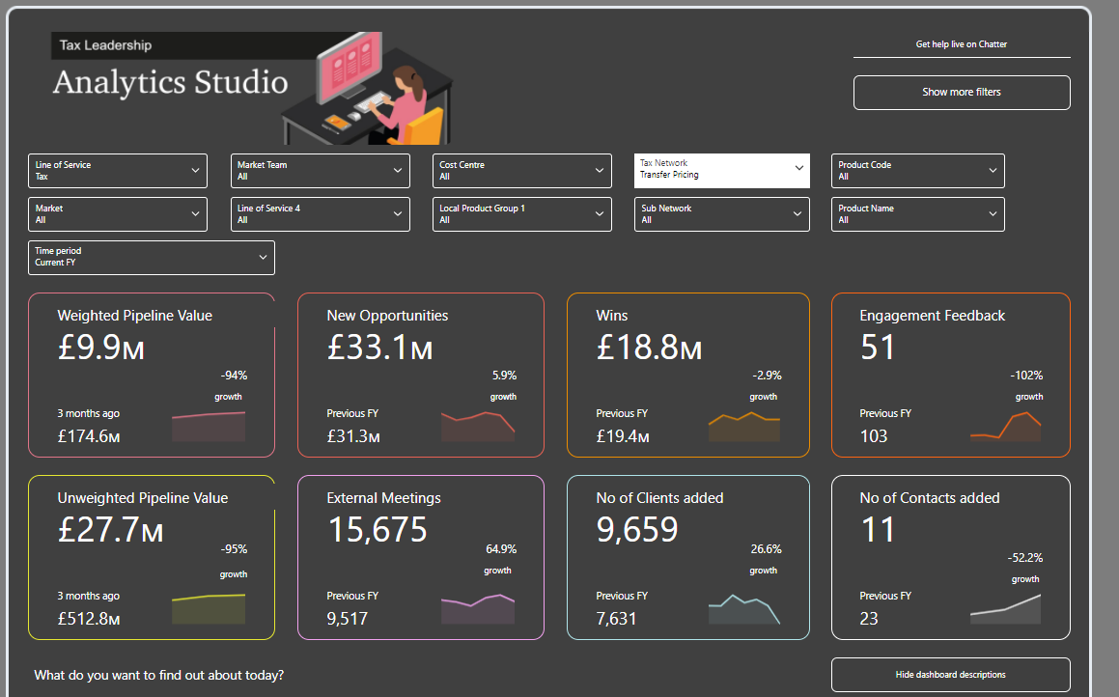
TP Network Salesforce Dashboard
Introduction┃Contents┃Business Development┃Propose┃Deliver┃Other
 | The Challenge Keeping track of all of the network’s opportunities.
 | Our Solution A summary tool that presents data for the overall UK network with applicable filters per team and even TP proposition.
 | Available insights Weighted Pipeline Value Unweighted Pipeline Value New Opportunities Wins Engagement Feedback External Meetings No of Clients added No of Contacts added
 | Available filters Market team Cost centre Product code FY Accounts Industries
 | Contact prith.vansia@pwc.com |  | Important links Link to dashboard
Business development
Internal

Slide 17
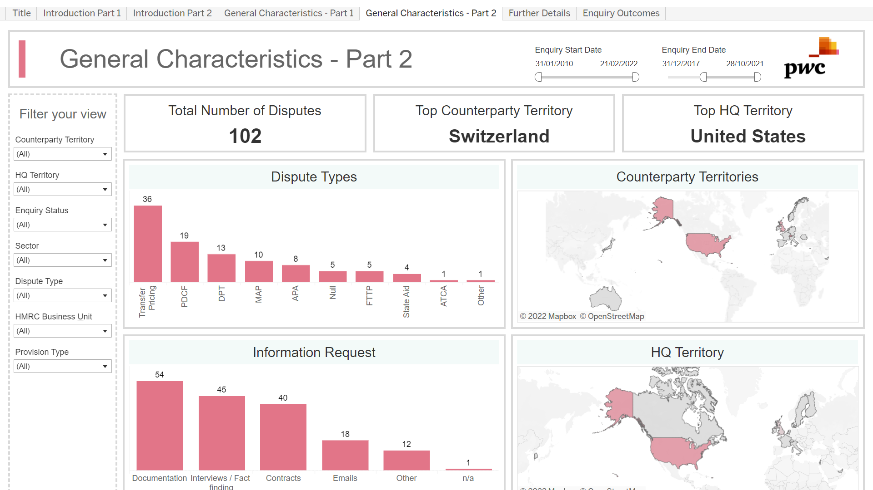
TP Disputes dashboard
Introduction┃Contents┃Business Development┃Propose┃Deliver┃Other
 | The Challenge Keeping track of all of the disputes which PwC are engaged to assist with, PwC’s responses to various dispute issues and HMRC’s stances and conclusion on various issues.
 | Our Solution A dashboard that presents relevant information on ongoing and historic disputes which PwC is involved in.
 | Purpose Ensure we are collecting data to track our work, understand trends and shine light on the key areas. Ensure all in our network have access to this data to leverage from and gain a better understanding relevant to their projects. Provide insights to communicate to clients our knowledge and expertise. |  | Available information Inter alia: Type of dispute Sector of client HMRC BU leading enquiry Provision subject to dispute Outcome of enquiry Enquiry timeframe Description of principles agreed with HMRC etc.
 | Dispute areas Transfer Pricing enquiries; APAs; MAPs; PDCF; State Aid; and ATCAs.
 | Contact oli.sabin@pwc.com sara.harris@pwc.com chris.booker@pwc.com |  | Important links New dashboard (and link) coming soon! Share information about your dispute to help strengthen the network’s database via this form (for new disputes) and this form (for concluded disputes)
Delivery (disputes)
Internal

Slide 18
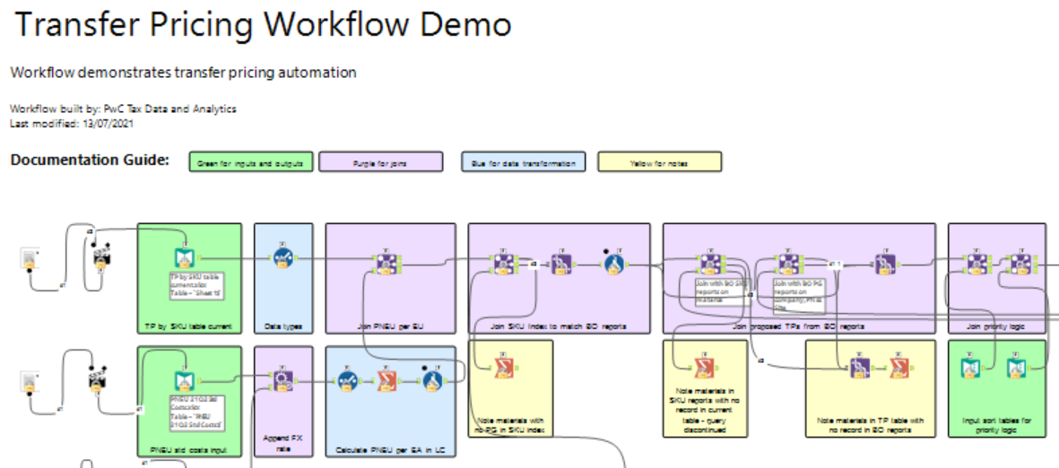
Resale price minus COGs true up Alteryx demo
Introduction┃Contents┃Business Development┃Propose┃Deliver┃Other
 | The Challenge Helping clients amend their intercompany pricing of COGs on a real time basis to prevent unnecessary tax charges and large year end adjustments.
 | Our Solution This workflow demonstrates how a client’s intercompany COGs can be adjusted to meet a predetermined resale price minus in an automated fashion.
 | Application & Industry For Our Solution Many clients will have needs for similar Alteryx solutions to perform their OpTP processes/
 | Pricing N/A - not specifically sold, new projects should be specifically scoped.
 | Contact john.mcsorley@pwc.com colin.k.robertson@pwc.com lucy.orme@pwc.com |  | Important links Link to drive file containing workflow
Delivery (Operational TP)
Internal

Slide 19
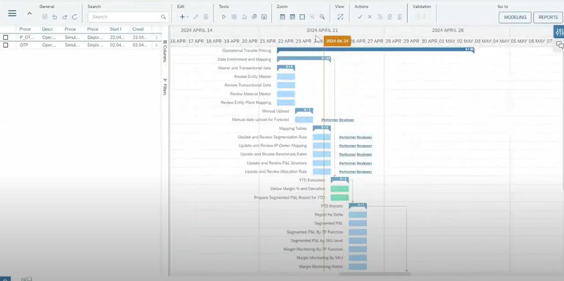
SAP Profitability and Performance Management (“PaPM”)
Introduction┃Contents┃Business Development┃Propose┃Deliver┃Other
 | The Challenge SAP Profitability and Performance Management (PaPM) is a comprehensive solution designed to address several key challenges faced by organizations in managing profitability and performance, including key transfer pricing processes, such as price setting, margin monitoring and P&L segmentation.
 | The Solution PaPM allows the user to perform detailed profitability analysis, allows for complex data integration, has capabilities for dynamic and flexible modelling /forecasting, cost allocation and reporting. PaPM also interfaces well with SAP Analytics Cloud, for visualisation purposes.
 | Application & Industry For Our Solution No Specific industry, but typically for very large organisations with complicated transfer pricing models. SAP is required as the clients ERP system for PaPM to work, as it is an SAP module.
 | Pricing Based on the number of entities on the system, and the total volume of intercompany sales.
 | Contact john.mcsorley@pwc.com colin.k.robertson@pwc.com robert.n.parker@pwc.com |  | Important links Link to website
Delivery (Operational TP)
Client facing

Slide 20
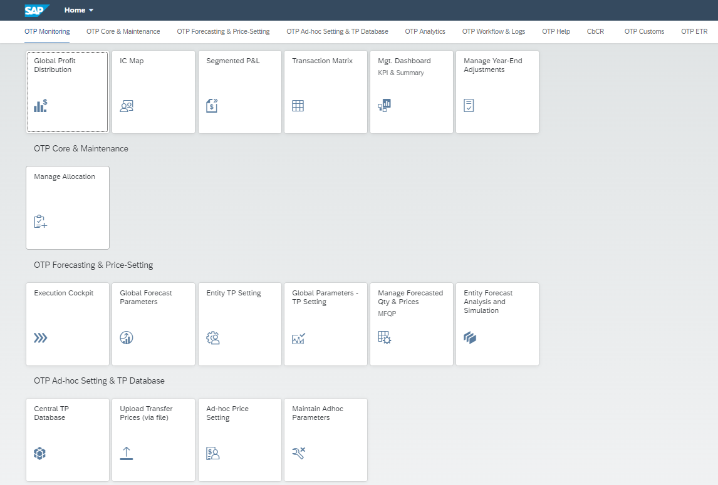
EXA Operational Transfer Pricing
Introduction┃Contents┃Business Development┃Propose┃Deliver┃Other
 | The Challenge EXA OTP is a comprehensive solution designed to address several key challenges faced by organizations in managing profitability and performance, including key transfer pricing processes, such as price setting, margin monitoring and P&L segmentation.
 | The Solution EXA allows the user to perform detailed profitability analysis, allows for complex data integration, has capabilities for dynamic and flexible modelling /forecasting, cost allocation and reporting. EXA is a very complete ot ot the box solution that has been designed with the user in mind. EXA’s data extractor can interface with a number of ERP systems.
 | Application & Industry For Our Solution No Specific industry, but typically for very large organisations with complicated transfer pricing models. SAP is not required as the clients ERP system for EXA to work.
 | Pricing Based on the number of entities on the system, and the total volume of intercompany sales.
 | Contact john.mcsorley@pwc.com colin.k.robertson@pwc.com milica.m.usljebrka@pwc.com |  | Important links Link to website
Delivery (Operational TP)
Client facing

Slide 21
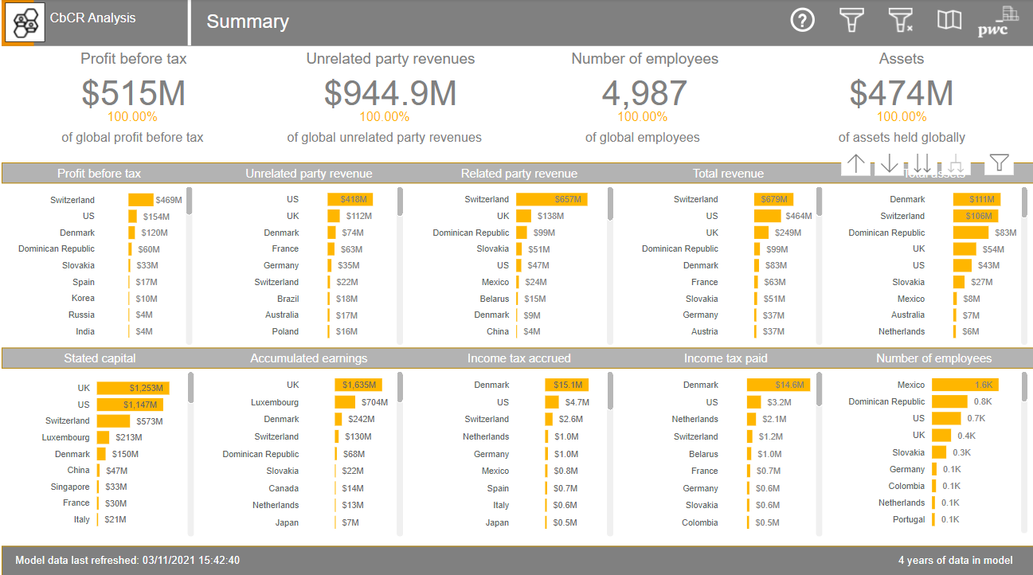
CbCR visualisation demo
Introduction┃Contents┃Business Development┃Propose┃Deliver┃Other
 | The Challenge The ability to scrutinise CbCR data in a visual and engaging way + visualise the Pillar II transitional safe harbour numbers upfront (based on the CbCR data).
 | Our Solution A tool that allows you to visualise and drill down into your client’s CbCR data to highlight anomalies and trends and it also starts the discussion on the Pillar II transitional safe harbour discussion.
 | Available Insights All available CbCR report data; Drill down by jurisdiction, entity and business activity; Comparison of multiple years; First cut of the Pillar II transitional safe harbour calculations.
 | Data required Minimum: 1x year of CbCR data - Table 1 only Nice to have: Multiple years of CbCR data - Table 1 and 2 plus associated Trial Balance build up
 | Pricing Speak to Martin, it starts at free albeit the logic is for you to make money.
 | Contact martin.s.kennedy@pwc.com daniella.cucca@pwc.com |  | Important links Link to CbCR visualisation demo
Business development
Delivery (advisory)
Client facing

Slide 22
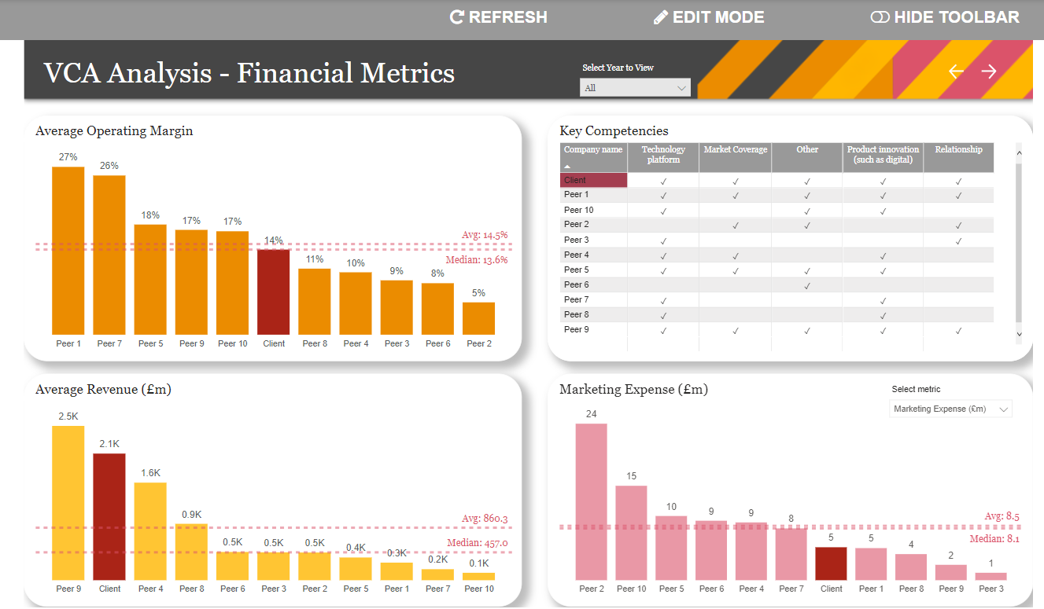
VCA visualisation demo
Introduction┃Contents┃Business Development┃Propose┃Deliver┃Other
 | The Challenge Helping client’s visualise the financial metrics of peer companies across their value chain.
 | Our Solution A tool allows you to visualise the key financial metrics of peer companies when performing a VCA.
 | Available Insights Operating margins of peers Average revenues of peers Key competencies of peers Marketing expenses of peers Value drivers by operating margin of peers
 | Pricing XYZ
 | Contact a.debenedictis@pwc.com colin.k.robertson@pwc.com lucy.cox@pwc.com |  | Important links Link to VCA visualisation demo
Delivery (advisory)
Delivery (Compliance)
Delivery (disputes)
Client facing

Slide 23
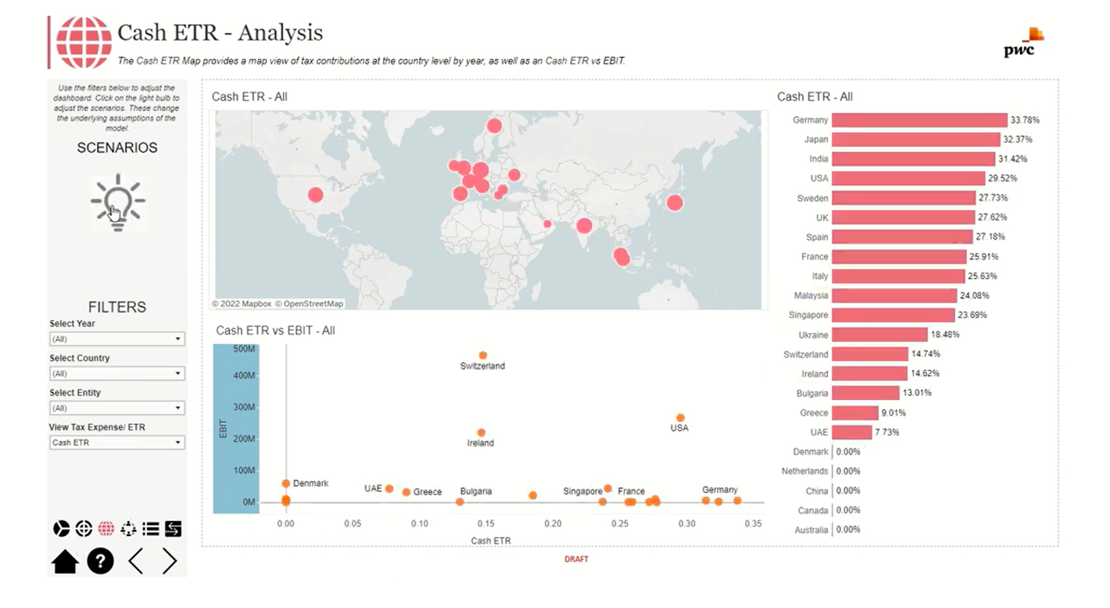
ETR model visualisation demo
Introduction┃Contents┃Business Development┃Propose┃Deliver┃Other
 | The Challenge Helping clients visualise their Group’s Effective Tax Rate considering multiple territories and tax rules with the ability to model ‘what if’ scenarios.
 | Our Solution A tool that allows you to visualise forecasts for all entities within a group, including the overlay of transfer pricing and tax attributes, to reach a forecast effective tax rate at an entity, country or group level. There is the option to model various scenarios to determine the optimal outcome when considering various options e.g for financing, transfer pricing policies or pillar-2 assessment.
 | Available Insights Breakdown of P&L with and without TP overlay, which can be filtered by entity or country. ETR waterfall to show impact of key tax attributes on cash ETR at group level. Breakdown of tax attributes over time, which can be filtered by entity or country. Map view of country level tax contribution by year Cash ETR vs EBIT on a country by country level Breakdown of all lines within the P&L, which can be viewed individually across all years within the model, and broken down by country/entity
 | Pricing From c. £45k, however will vary significantly depending on the level of data manipulation required, and extent of scenario modelling.
 | Contact novella.de.renzo@pwc.com payal.x.chordia@pwc.com laura.s.simpson@pwc.com |  | Important links Video demo
Business development
Delivery (advisory)
Client facing

Slide 24
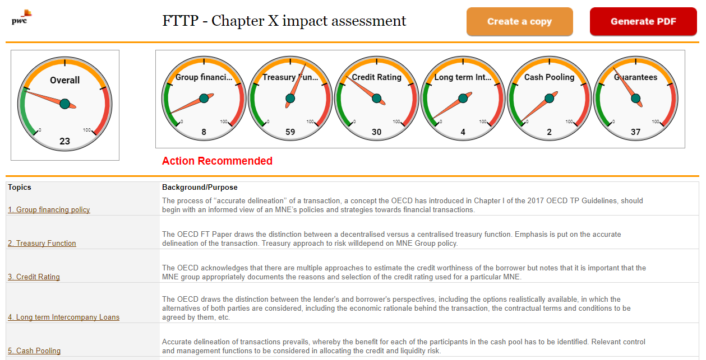
Chapter X impact assessment tool
Introduction┃Contents┃Business Development┃Propose┃Deliver┃Other
 | The Challenge Identifying and articulating the risks, opportunities and changes resulting from the OECD’s Chapter X guidance.
 | Our Solution A tool that helps you discuss the matters raised in the Financial Transactions Paper (Chapter X of the OECD Guidelines) versus your client’s existing policies. This will give them a steer as to whether they are "green", "amber" or "red" in the respective areas.
 | Guidance & training Guidance for using the Chapter X impact assessment tool
 | Pricing Typically free of charge if likelihood of future work, otherwise a small time & expenses fee.
 | Contact A member of the Debt Hub team. UK_Tax-Midlands-Debt-Hub@pwc.com |  | Important links Chapter X impact assessment tool
Business development
Delivery (advisory)
Client facing

Slide 25
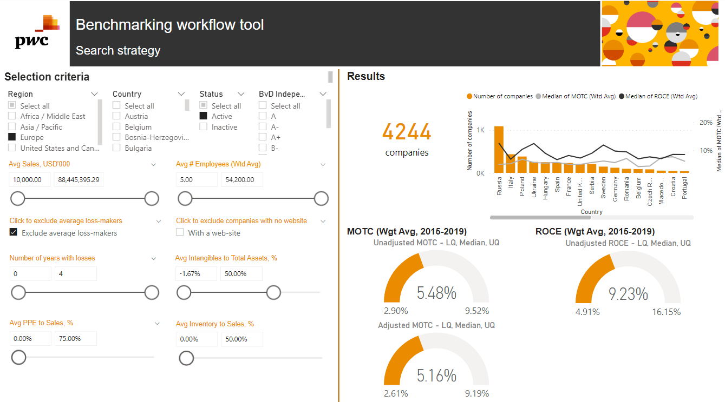
Benchmarking visualisation
Introduction┃Contents┃Business Development┃Propose┃Deliver┃Other
 | The Challenge Explaining and presenting the benchmarking process and results to clients in an engaging way.
 | Our Solution PwC developed tool / visualisation allows you to follow the benchmarking process from start to finish in the interactive way, as well as to gain additional data insights from analysing the comparables data: Tailored interactive dashboard available to clients via a link shared by PwC Provides insights into the changes in comparables population depending on the search criteria / rejection reasons Provides insights into the results allocated into subsets (by product / service type, local independence requirements etc) Creates audit trail Intuitive and easy to interact with. For the overview of tool’s capabilities, refer to this slide
 | Guidance & training Mention that you need visualisation in your benchmarking request
 | Pricing Typically free of charge. Use the visualisation as an add-on to preserve your proposed fees
 | Contact martin.s.kennedy@pwc.com anastasiia.melnyk@pwc.com |  | Important links Demo benchmarking visualisation tool
Delivery (advisory)
Delivery (Compliance)
Client facing

Slide 26
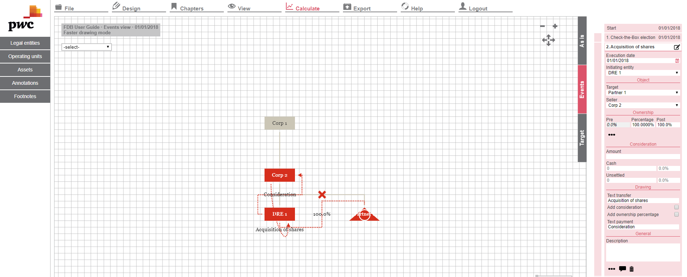
Financial Drawing Board
Introduction┃Contents┃Business Development┃Propose┃Deliver┃Other
 | The Challenge Time spent creating organisation charts, diagrams for steps paper etc.
 | Our Solution This web-based tool allows users to create diagrams quickly and easily, which can then be exported directly into a PowerPoint slide for presentation and delivery to clients.
 | Guidance & training User guide
 | Contact caroline.m.conaghan@pwc.com |  | Important links Link to tool PwC US microsite - which includes some short videos
Delivery (advisory)
Client facing

Slide 27
Broad application platforms

Slide 28


Harvey
Introduction┃Contents┃Business Development┃Propose┃Deliver┃Other
 | The Challenge The need for staff to spend time on manual or simple tasks, and how this can be automated or augmented to save time whilst maintaining the quality of work.
 | Our Solution Harvey is a third-party generative AI solution - owned by Counsel AI - that can perform complex legal tasks via a web-based natural language interface. Users can ask open-ended legal and legal-adjacent questions and also upload documents or datasets for Harvey to analyse and ask natural language questions about those documents or datasets.
 | Key tool features Assist - chat or iterate on top of responses. Draft - Allows users the ability to track changes when you follow-up to a response to a prompt to see how the tool is updating the response. Library - Libraries allows a user to save and share prompts with their teams. Workflow Discovery - This workflow allows you to upload up to 100 documents and instantly produce a report which provides a snapshot view of key diligence topics and value areas when considering a deal Redlines - Redline Analysis generates a chart comparing the original and revised version of a redline document based on topics you identify or generates a response to your query based on the redline document. Translation - This feature allows for the seamless translation of PDF documents from one language to another, supporting a diverse range of languages. Research Edgar - Harvey will answer questions or generate new content based US regulatory filings (Form 10-K, Form 10-Q, Form DEF 14A,Form 8-K.
 | Contact michael.j.gauer@pwc.com ignas.matevicius@pwc.com james.schaefer@pwc.com |  | Important links Harvey
Business development
Delivery (advisory)
Delivery (Operational TP)
Delivery (Compliance)
Delivery (disputes)
Admin
Internal

Slide 29

ChatGPT Enterprise
Introduction┃Contents┃Business Development┃Propose┃Deliver┃Other
 | The Challenge The need for staff to spend time on manual or simple tasks, and how this can be automated or augmented to save time whilst maintaining the quality of work.
 | Our Solution ChatGPT Enterprise is a subscription-based plan launched on August 28, 2023. It offers enterprise-grade security and privacy, unlimited higher-speed access to GPT-4, longer context windows for processing longer inputs, advanced data analysis capabilities, customisation options, and much more. PwC UK had a personalised training session with OpenAI. The video covers: Brief history of OpenAI ChatGPT Enterprise Prompt Engineering Introducing brand new GPTs & demo Actions in GPTs Live demos of GPTs created by us
 | Key tool features Natural Language Understanding and Generation Versatility in Applications Multilingual Capabilities Personalisation and Customisation Accessibility and Integration
 | Contact michael.j.gauer@pwc.com ignas.matevicius@pwc.com |  | Important links Tool access Demo
Business development
Delivery (advisory)
Delivery (Operational TP)
Delivery (Compliance)
Delivery (disputes)
Admin
Internal

Slide 30

Microsoft Copilot
Introduction┃Contents┃Business Development┃Propose┃Deliver┃Other
 | The Challenge The need for staff to spend time on manual or simple tasks, and how this can be automated or augmented to save time whilst maintaining the quality of work.
 | Our Solution Microsoft 365 Copilot is an AI-powered productivity tool that uses large language models (LLMs) and integrates data with the Microsoft Graph and Microsoft 365 apps and services. It works alongside popular Microsoft 365 apps such as Word, Excel, PowerPoint, Outlook, Teams, and more. Copilot provides real-time intelligent assistance, enabling users to enhance their creativity, productivity, and skills There are some short guides available that may be helpful in understanding its potential.
 | Key tool features Integration with Microsoft 365 Apps Automation and Task Management Data Insights and Analysis Enhanced Collaboration
 | Contact michael.j.gauer@pwc.com ignas.matevicius@pwc.com james.schaefer@pwc.com |  | Important links Microsoft Copilot
Business development
Delivery (advisory)
Delivery (Operational TP)
Delivery (Compliance)
Delivery (disputes)
Admin
Internal

Slide 31
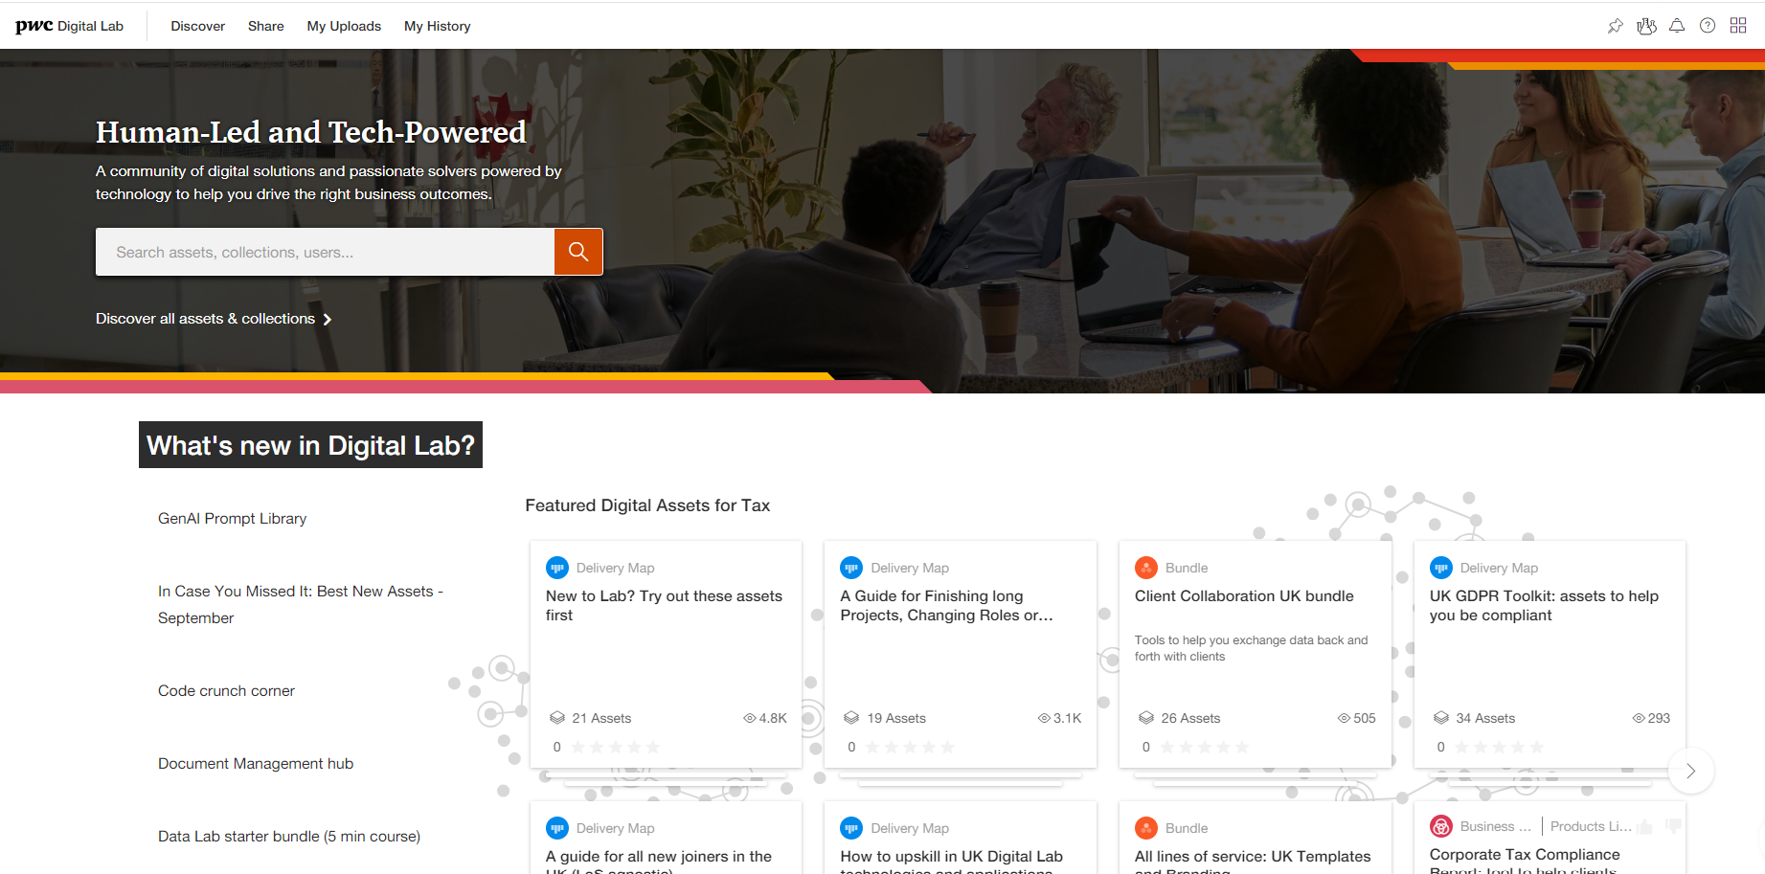
Digital Labs
Introduction┃Contents┃Business Development┃Propose┃Deliver┃Other
 | The Challenge
 | Our Solution
 | Key tool features
 | Contact |  | Important links
Business development
Delivery (advisory)
Delivery (Operational TP)
Delivery (Compliance)
Delivery (disputes)
Admin
Internal

Slide 32
Financial Insights
Introduction┃Contents┃Business Development┃Propose┃Deliver┃Other
 | The Challenge Viewing financial management information for your projects, team and self at the click of a few buttons.
 | Our Solution Financial Insights combines a number of Finance Management Information solutions from across the firm into an accessible self-serve format, presenting working capital and revenue metrics for billing partners and managers as well as individual personal performance hours data for everyone.
 | Key tool features Ability to view: Unbilled WIP WIP coverage Engagement value Bill targets Cash received Cash targets Debtors Overdue debts Analysis of chargeables hours and time sheet information
 | Contact uk_financial_insights_support@pwc.com |  | Important links See emails from ‘uk_financial_insights_support@pwc.com’ for a link to your dashboard
Delivery (advisory)
Delivery (Compliance)
Internal

Slide 33
Teams and ADMs

Slide 34
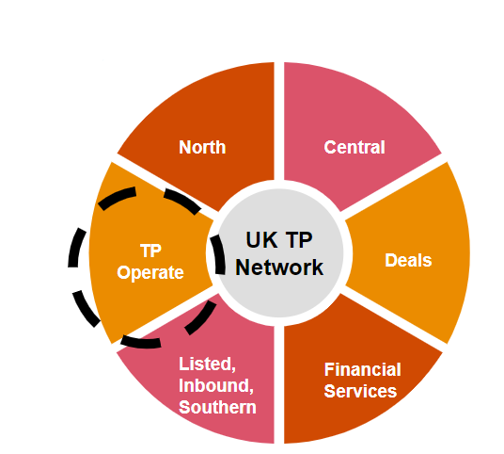
TP Operate
Introduction┃Contents┃Business Development┃Propose┃Deliver┃Other
 | The Challenge Delivering similar projects to multiple clients in a time efficient and consistent way.
 | Our Solution Our TP Operate team. The team consists of TP dedicated Senior Associates / Associates who are skilled in, but not limited to, the following areas: TP benchmarking TP documentation Ad-hoc TP consulting
 | How to use the team Complete the TP Operate request form here. Hourly Market value rates range between c.£42 - £72 and standard cost rates per hour between c.£34 - £59 The TP Operate team should be primarily used for TP technical tasks. If you require support for non-TP technical tasks please use the ADM self-service hubs.
 | Contact steve.lord@pwc.com caoilin.kearns@pwc.com conor.richmond@pwc.com |  | Important links TP Operate resource request form TP Operate feedback form TP Operate guidance TP Operate intranet site
Business development
Delivery (advisory)
Delivery (Operational TP)
Delivery (Compliance)
Delivery (disputes)
Admin
Internal

Slide 35
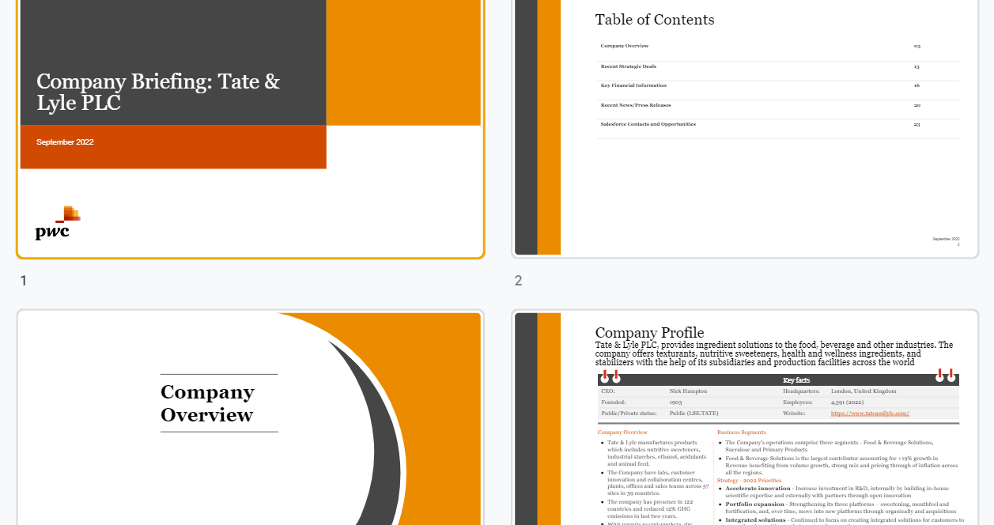
MNE Company Briefing
Introduction┃Contents┃Business Development┃Propose┃Deliver┃Other
 | The Challenge Completing rapid research or in-depth analysis for projects to multiple clients in a time efficient and consistent way
 | Our Solution Using the ‘MNE company briefing’ template, Alternative Delivery Model support teams with the skilled and experienced people, to streamline the process of gathering information on companies.This frees up your time on researching to ensure focus on your client. The research template focuses on the activities and the financials of the target company to help identify where there might be potential tax opportunities. One of the key benefits of the company briefing template is that it allows better targeting in a resource efficient manner and can be turned around within 3-5 days. If you need information on a specific item not in the template or you are working on a slightly tighter deadline, this can be flagged in the form as part of your request to the ADM.
 | Guidance & training Complete the ADM request form - Research State that the ‘MNE Company Briefing’ template be used £29 cost per hour (based on a typical investment time of two days) - Kolkata Costs can vary depending on group size The ADM teams should be primarily used for non-TP technical tasks. If you require support for TP technical tasks please use TP Operate.
 | Contact fernando.lopez@pwc.com |  | Important links UK Tax Form Research ADM Example of research using template
Business development
Delivery (advisory)
Delivery (Operational TP)
Delivery (Compliance)
Delivery (disputes)
Admin
Internal

Slide 36

ADM self-service hubs
Introduction┃Contents┃Business Development┃Propose┃Deliver┃Other
 | The Challenge Completing routine tasks for projects to multiple clients in a time efficient and consistent way.
 | Our Solution Alternative Delivery Model support teams with the skilled and experienced people, freeing up your time to focus on your clients. The SMEs in each of the hubs can support you with the following services. Proposal Content - Tax teams can work with the proposals hub on a range of proposal support, including design and creative content (including videos and google sites), proofreading and editorial support. Research - The team can provide both rapid research (industry / company research) and in-depth analysis (competitor intelligence, benchmarking, thought leadership support) Data Analytics - The team can help transform data into a workable format and generate insightful dashboards both for you and your client using systems such as Alteryx, PowerBI or Tableau Project Management - The PM team have a range of skills and expertise to help manage projects from start to finish, supporting delivery of projects against scope, quality and budget - offering both project management and business analyst services
 | How to use the teams Complete the ADM request form - Proposal Content / Research / Data Analytics / Project Management £26 cost per hour for Proposals, Research and Data Analytics ADM teams- Kolkata £37 cost per hour for Project Management ADM team- Northern Ireland The ADM teams should be primarily used for non-TP technical tasks. If you require support for TP technical tasks please use TP Operate.
 | Contact tracey.j.crowder@pwc.com |  | Important links UK Tax Alternative Delivery Model Support site
Business development
Delivery (advisory)
Delivery (Operational TP)
Delivery (Compliance)
Delivery (disputes)
Admin
Internal

Slide 37

Debt Hub
Introduction┃Contents┃Business Development┃Propose┃Deliver┃Other
 | The Challenge Completing complex work related to the transfer pricing of debt in a time efficient and consistent way.
 | Our Solution A centre of excellence for transfer pricing of debt work for the national TP network. This "hub" is to perform the underlying analysis on debt related projects going forward, utilising a new global financial transactions transfer pricing ("FTTP") tool and other technology available.
 | Key Aims of the Debt Hub The key aims of the hub are to: Achieve consistency, in terms of both quality & approach; Drive efficiency by utilising the FTTP tool, other technology and templates; and Contribute and drive innovation and thought leadership to optimise market opportunities.
 | How the Debt Hub can help Indicative credit rating analysis; Interest rate benchmarking using the FTTP tool; Debt capacity analysis using multiple data sources (S&P, internal CUPs, wider group / competitor metrics etc.); Thin capitalisation ratio analysis; Guarantee fee benchmarking; Underlying analysis for cash pool arrangements; and Production of UK debt transfer pricing documentation.
 | Contact UK_Tax-Midlands-Debt-Hub@pwc.com james.andrews@pwc.com andrew.cotterill@pwc.com
Business development
Delivery (advisory)
Delivery (Operational TP)
Delivery (Compliance)
Delivery (disputes)
Admin
Internal

Slide 38
TO BE REMOVED

Slide 39
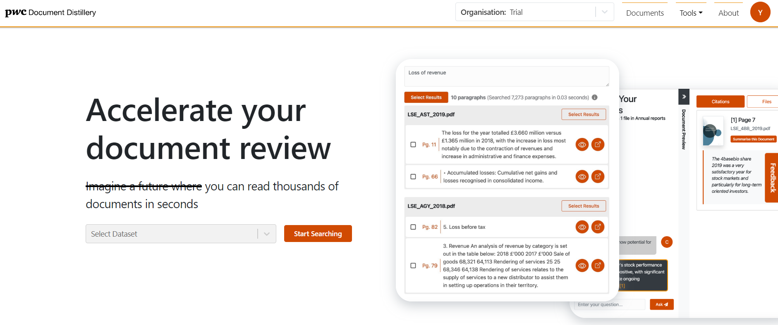
Document Distillery
Introduction┃Contents┃Business Development┃Propose┃Deliver┃Other
 | The Challenge Searching for word terms and themes in multiple documents efficiently.
 | Our Solution A document review platform that allows domain experts to reach better conclusions faster. Get started with Document Distillery Step 1: Create a Dataset Select ‘Documents’ in menu, upload your own documents to a Dataset. You can also create a Group, where you can link multiple datasets, allowing you to quickly broaden your search. You can share this, so other people can own, edit or view it. Step 2: Search Select 'Search' from the top of the Dataset/Group information page. Press Next and select either ‘Keyword Search’ for a word term or ‘Similarity Search’ for a similar themed word’. Enter your search query on the search text box and view results Step 3: Chat with your document This allows you to ask questions about your document in natural language. Select Tools, Chat with your Documents to begin .Works best with single or few documents.
 | Key tool features & TP feedback You can upload a collection of documents securely and query them using specific searches in Document Distillery. Ability to search pre-set indexes such as the S&P 500, FTSE 350 and Companies House. “The document review process was manual and time consuming, requiring the download of documents from the web and a manual search through them. The team used Document Distillery to query S&P 500 annual reports, revealing an estimated ≈40% time saving on research tasks, which accounts for 50% of project time.”
 | Contact yvonne.l.lee@pwc.com chloe.collins@pwc.com |  | Important links Document Distillery tool Document Distillery user guide
Data driven
Time saving
Easy to use
Business development
Delivery (advisory)
Delivery (Operational TP)
Delivery (Compliance)
Delivery (disputes)
Admin
Internal

Slide 40

Document automation (DocGen)
Introduction┃Contents┃Business Development┃Propose┃Deliver┃Other
 | The Challenge Producing the same or similar documents on a frequent basis in a time efficient and consistent way.
 | Our Solution A web-based application that allows the automation of Google Documents / Slides for a number of different use cases including, but not limited to: Technical Reports, Client Proposals, Engagement Letters. The tool significantly increases efficiencies and reduces the scope for error when preparing deliverables. The app supports a myriad of questions, conditional logic, can pull in information from Sheets, Images etc and insert them all into a document based off a master template. This document is then handed to the end-user for topping & tailing / making any other changes as they see fit. To create a new instance of DocGen click here or reach out to your local TP Technologist / DA.
 | Guidance & training Training video Training slides Instruction manual
 | Contact michael.p.salisbury@pwc.com vladut.ene@pwc.com georgia.b.bostock@pwc.com
Consistent deliverables
Template
Efficient

Slide 41
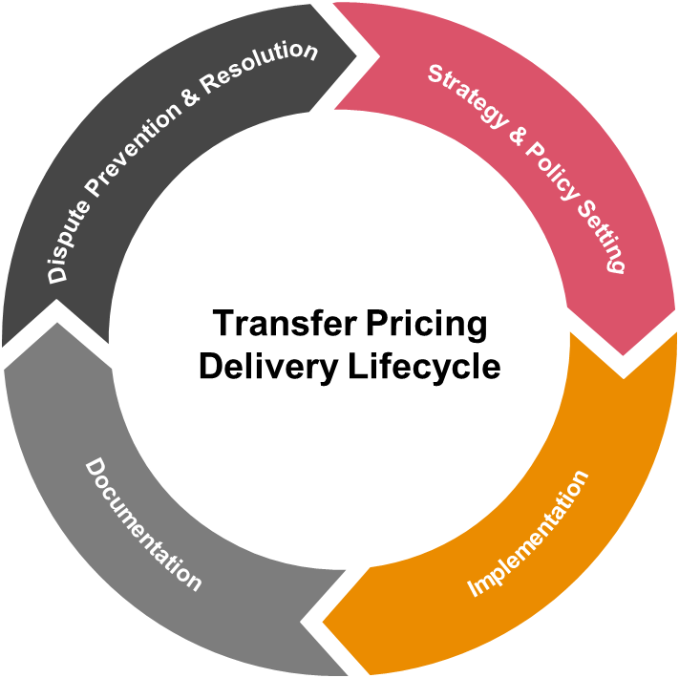
Introduction┃Contents┃Business Development┃Propose┃Deliver┃Other
Demo a Tool
Economically significant functions demo
Disputes risk profiling demo
Benchmarking visualisation demo
Operational TP demos

Slide 42
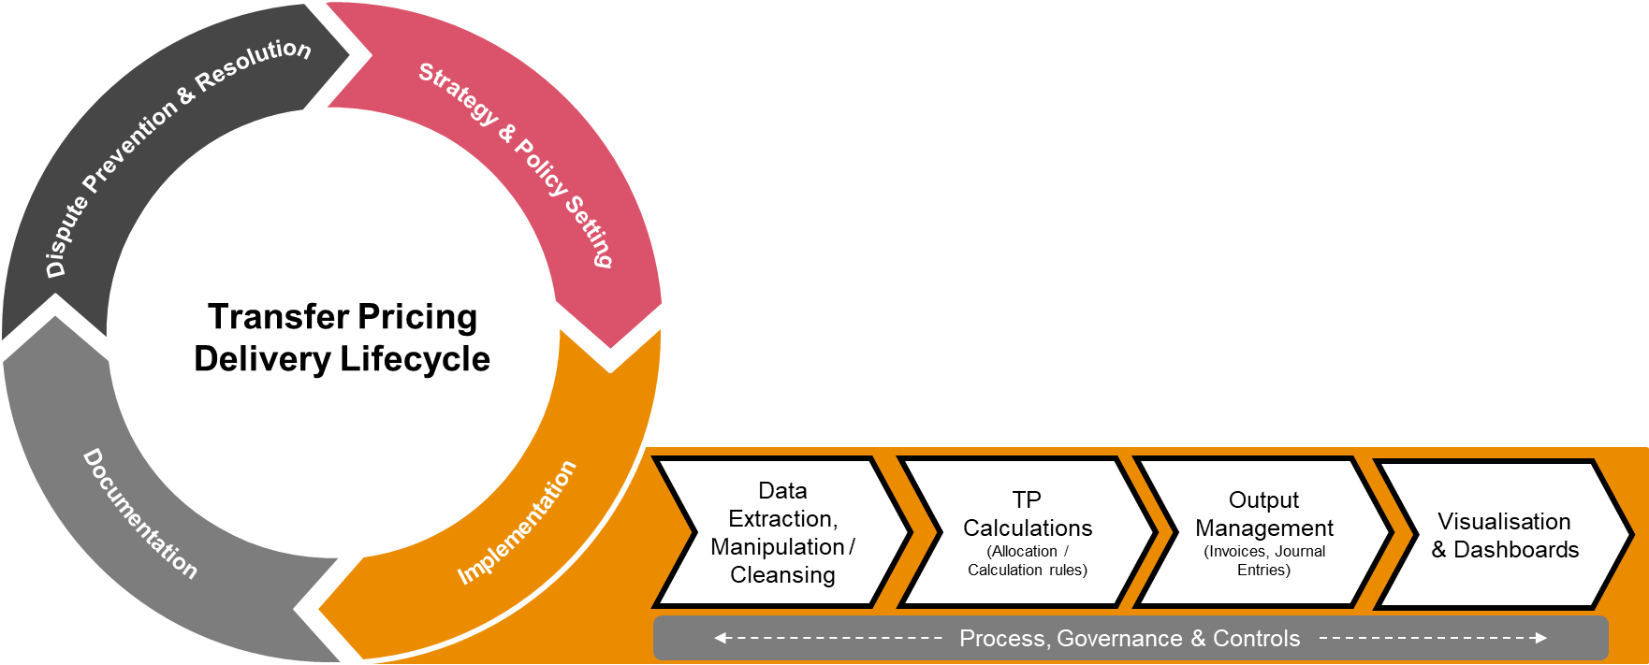
Introduction┃Contents┃Business Development┃Propose┃Deliver┃Other
Operational TP demos
CbCR visualisation demo
Resale price minus COGs true up Alteryx demo
Headquarter recharges visualisation demo
VCA visualisation demo
Operational TP healthcheck

Slide 43
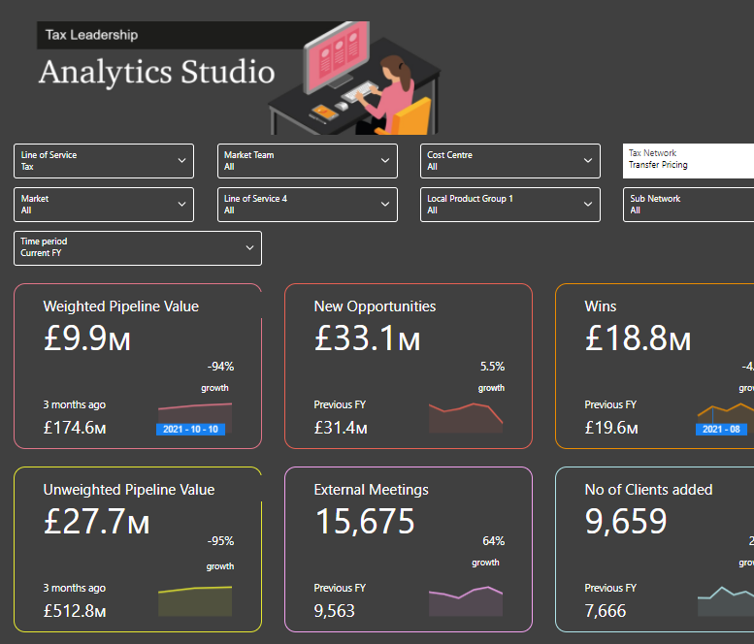
Introduction┃Contents┃Business Development┃Propose┃Deliver┃Other
Business Development
Targeting
Opportunity Tracking
Targeting
Opportunity Tracking
Risk Profiling Tool
TP Network Salesforce Dashboard

Slide 44
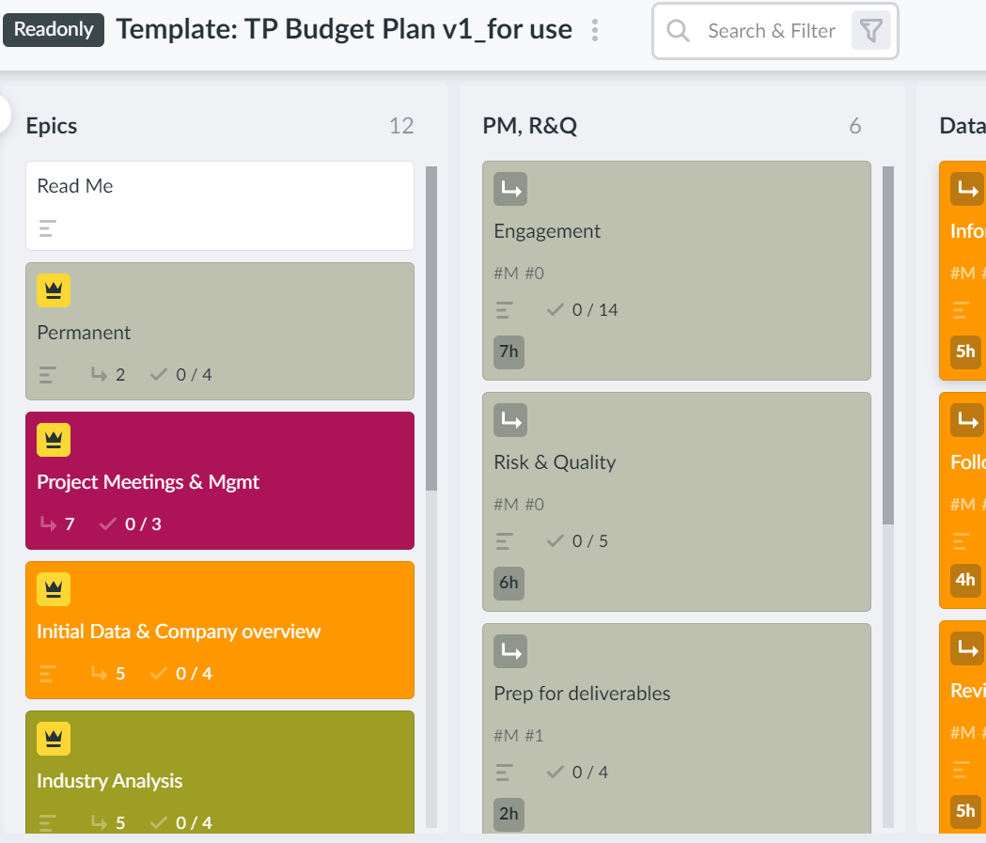
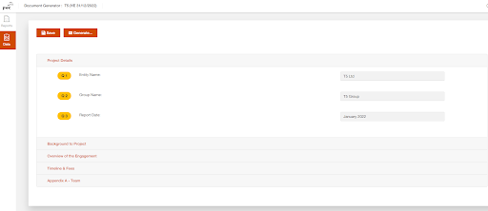
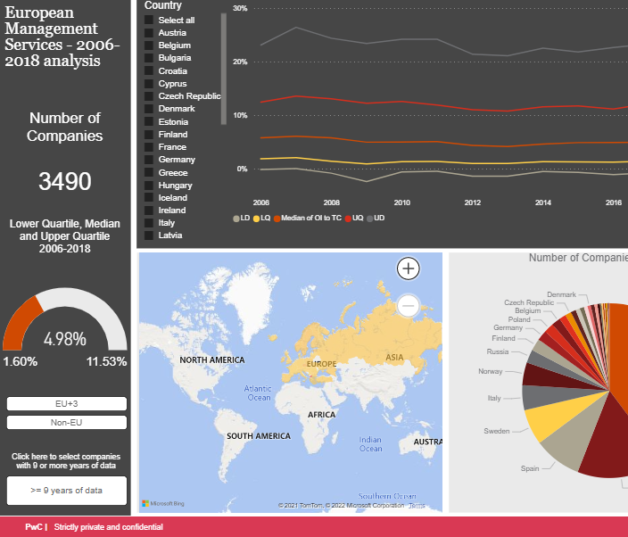
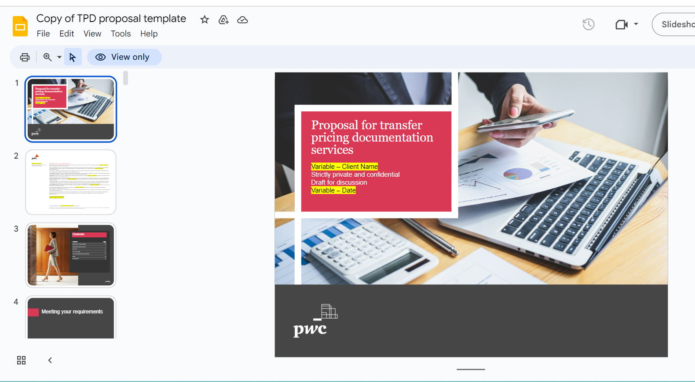
Introduction┃Contents┃Business Development┃Propose┃Deliver┃Other
Proposal Generators
Price a Project
Create a Proposal
Demo a Tool
Price a Project
Propose
TPD Proposal Template
Demo a Tool

Slide 45

Tax Opportunities Portal
Introduction┃Contents┃Business Development┃Propose┃Deliver┃Other
 | The Challenge Fairly resourcing opportunities within the network and firm.
 | Our Solution The Tax Opportunities Portal is a live virtual hub advertising projects across Tax as well as Firm Wide opportunities. The aim of the portal is to provide transparency on the roles we have available and Fair Access to Work.
 | How to use it Requesting resource - Please use the request resource button on the portal homepage, remembering to fill in as much information as possible and add any specific information you feel needs to known. Seeking opportunities - When you are looking for work, remember to review your local opportunities board (and others if applicable) within the portal and keep an eye on your Google Hangouts for push notifications of new roles. Profile & capacity updates - Please make sure you have updated your Workday Skills Profile and you regularly update your bookings in S&D so your resourcing team knows if you have capacity.
 | Contact Your local resourcing contact |  | Important links Link to Tax Opportunities Portal Link to video guidance Link to training slides
Time saver
Easy to use
Template

Slide 46
TPD Proposal Template
Introduction┃Contents┃Business Development┃Propose┃Deliver┃Other
 | The Challenge Designing slides to be comprehensive, covering all potential transfer pricing compliance offerings (CbCR, Master File, Local Files and local TP forms) and different alternative approaches (e.g. allocation of responsibilities between PwC and the client, duration of the engagement, etc.)
 | Key features of our solution The template is consistent with our current network TP documentation strategy Been prepared by leveraging the best bits from a number of recent successful GCD proposals. The template will require customisation to meet the client's specific requirements and circumstances but it should provide a good, consistent starting point and allow us to complete the first 30% - 50% of a proposal more quickly and easily. A number of comments are included in the Google document to provide guidance on the inclusion and/or content of certain pages (including where more than one alternative option is provided). Additionally, a number of common variable terms are highlighted in yellow in the document. The intention is to automate this proposal next, at which point the need for this guidance and the alternatives should be significantly reduced.
 | Guidance The template can be accessed via the link below and will also be available on the TP Network site under Operational Efficiency >> Documentation. To create your proposal, go into the template, click File >> Make a Copy, and make sure you tick the ‘Copy comments and suggestions’ option. Please DO NOT make edits in the core template document itself - if you have any suggestions or spot an error, please reach out to the team who will update it directly.
 | Contact caoilin.kearns@pwc.com will.barritt@pwc.com |  | Important links TPD proposal template
Time saver
Easy to use
Template

Slide 47
Introduction┃Contents┃Business Development┃Propose┃Deliver┃Other
Financial Insights
Tax Opportunities Portal
Financial Insights
Other
Tax Opportunities Portal

Slide 48

UK local file automation template
Introduction┃Contents┃Business Development┃Propose┃Deliver┃Other
 | The Challenge Creating a pre-populated template to document client’s transfer pricing policies.
 | Key features of our solution Complete a questionnaire with the basic client information i.e name, year end and description of transactions Generates a report based on the Local file template Includes all of the key sections and creates a “pro-forma” for the economic analysis and 6-step risk analysis for two straightforward categories of transactions - limited risk distribution and provision of services between two counterparties. Will save time and reduce errors from rolling forward from missing small updates
 | Guidance & training Guidance notes throughout the document to provide suggestions and advice on the content for each section, and link to further resources. The template can be accessed via the link to the right and will also be available on the TP Network site under Operational Efficiency >> Documentation. To create your local file, open this link. Add a new client and set it as active. Move to the data section (accessed by the left hand side) and complete the attached questionnaire Generate the report and then open in Google docs. Review as normal from there and add the required additional detail. Detailed instructions can be accessed here. For guidance on which version to use (2022 v 2017), click here.
 | Contact david.oak@pwc.com fernando.lopez@pwc.com hannah.l.owen@pwc.com |  | Important links 2022 UK Local file automation template Instruction guidance for automation tool
Time saver
Easy to use
``
``````````
Template

Slide 49
Introduction┃Contents┃Business Development┃Propose┃Deliver┃Other
TP Disputes Experience dashboard
Covid TP impact assessment tool
ETR tool
Chapter X impact assessment tool
Risk Profiling Tool
Economically significant functions
Function & Risk Analysis tool
Tax Bot
Company Data Portal Search
Company Data Portal Benchmarking
Automated UK local file template
MNE Company Briefing
UK local file template
Benchmarking visualisation
Tax Transparency Intelligence
TP Reporting Suite
Document Distillery
CbCR tool
Financial Drawing Board
GCD Reporter
Data Lab
Thin Cap F&D PE report automator
Operational TP Tools
Debt Hub
Disputes
Strategy & Policy Setting
Implementation
Documentation
Document automation (DocGen)
ADM self-service hubs
TP Operate
Deliver

Slide 50
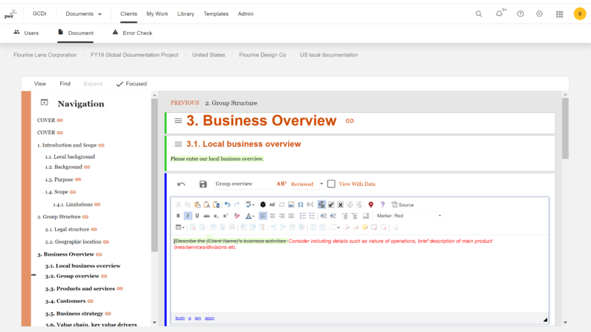
GCD Reporter
Introduction┃Contents┃Business Development┃Propose┃Deliver┃Other
 | The Challenge Delivering large documentation projects in a tech enabled way.
 | Our Solution A proprietary software solution that provides an unbeatable combination of efficiency and real-time user friendly collaboration for compliance with various jurisdiction transfer pricing documentation requirements.
 | Key tool features A full-featured web environment allows for collaboration without the need to upload or download documents Ability to leave comments and track changes across all your reports from a single interface Synchronisation of model report/template and local country report with simplicity and elegance View updated economic and financial analyses in real-time leveraging the power of PwC’s internal analytic platforms Monitor the status of the overall global documentation study and the status of each specific territory filing Workflow dashboard to assign tasks and review reports
 | Contact david.oak@pwc.com fernando.lopez@pwc.com hannah.l.owen@pwc.com |  | Important links GCD Reporter tool GCD Reporter marketing slides GCD Reporter internal user guide GCD Reporter demo video GCD Reporter Global useful links
Time saver
Easy to use
Template
Client facing
Doc

Slide 51
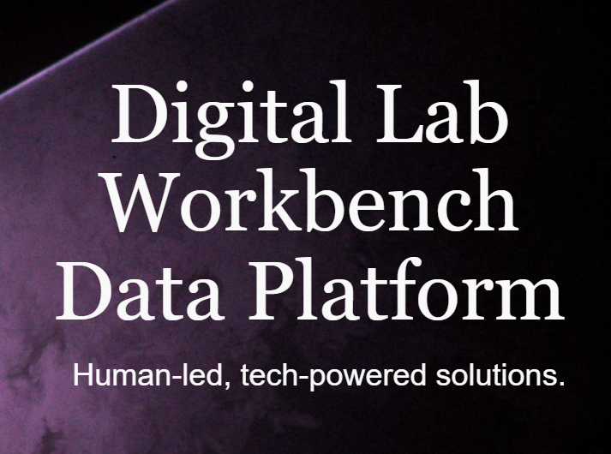
Data Lab
Introduction┃Contents┃Business Development┃Propose┃Deliver┃Other
 | The Challenge Managing third party / external data.
 | Our Solution We’ve launched Data Lab, the new home of third party data assets. Data Lab sits within Digital Lab and is an easy, centralised resource for all our people to access and search for third party data to help solve business problems. Whether you’re looking for information on an individual who leads an organisation, a specific company, industry, market or macroeconomic environment, there’s data to help complete the picture. Data Lab is easy to use and saves time and money spent on buying the same data twice. For experienced data users, you can benefit from data available via APIs. You can access large volumes of data, download Alteryx macros, and change parameters to extract the data you need.
 | Guidance & training Visit the Help and Support microsite for training materials, tips and guidance.
 | Contact For help and support with Data Lab, please visit here or reach out to your local digital accelerator. |  | Important links Watch this short video to find out more. Data Lab is accessible via Digital Lab, click here to view the data sets in Data Lab.
Data Driven
Easy to use
Time saver
Internal
IE&E

Slide 52
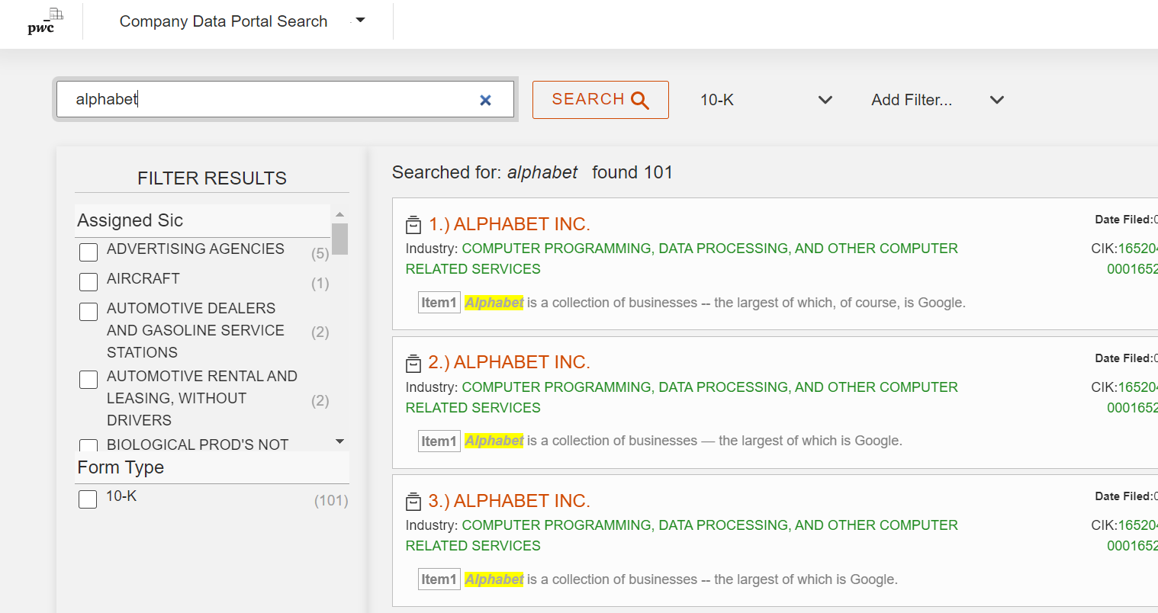
Company Data Portal Search
Introduction┃Contents┃Business Development┃Propose┃Deliver┃Other
 | The Challenge Searching for word terms in multiple statutory filings.
 | Our Solution The Company Data Portal is a development application that has two main types of searches: full text across filings, or target full text search across sections of the 10-K.
 | Guidance & training Link to guidance document Link to training videos
 | Contact james.andrews@pwc.com jack.korny@pwc.com james.schaefer@pwc.com |  | Important links Company Data Portal Search tool
Time saver
Easy to use
Template
Internal
I&A

Slide 53
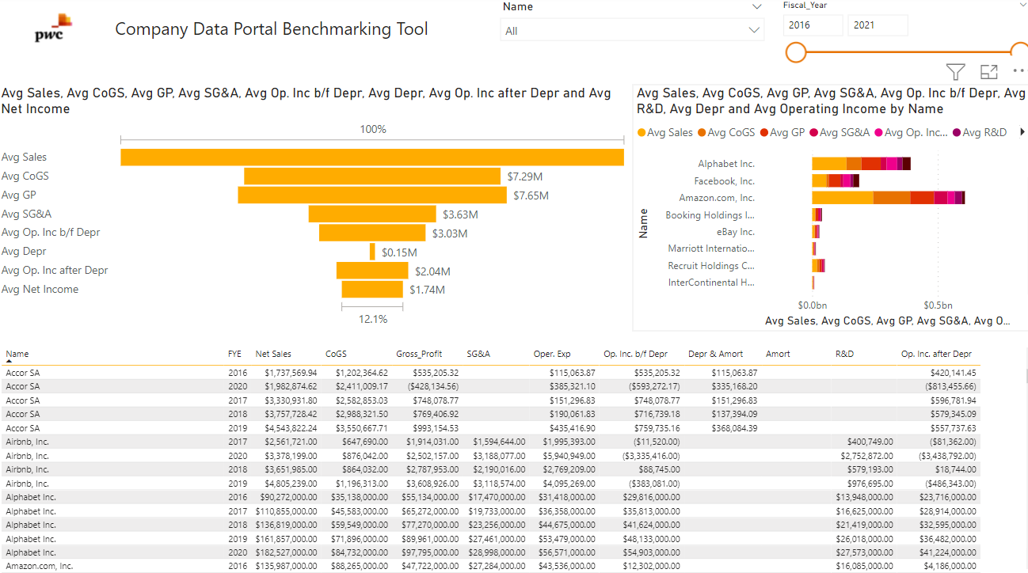
Company Data Portal Benchmarking
Introduction┃Contents┃Business Development┃Propose┃Deliver┃Other
 | The Challenge Identifying competitors of a client and efficiently extracting their financial information.
 | Our Solution The Company Data Portal Benchmarking tool provides you with a list of a searched company’s competitors along with the competitors’ financial data from their statutory accounts. The tool allows you to download the data as an excel file and as a PowerBI file which highlights specific trends and visuals.
 | Guidance & training TBC
 | Contact james.andrews@pwc.com jack.korny@pwc.com james.schaefer@pwc.com |  | Important links Company Data Portal Benchmarking tool
Time saver
Easy to use
Template
Internal
I&A

Slide 54
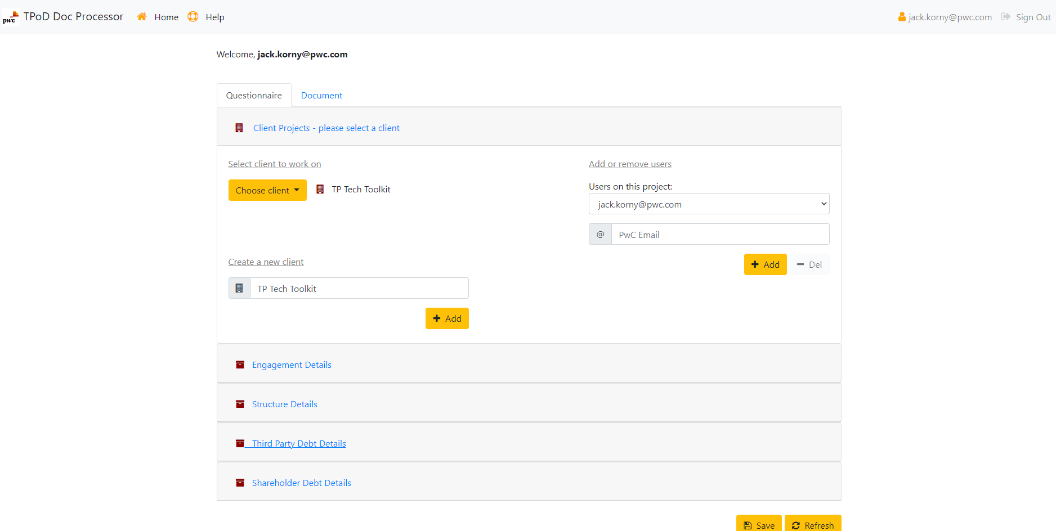
Thin Cap F&D PE report automator
Introduction┃Contents┃Business Development┃Propose┃Deliver┃Other
 | The Challenge Creating multiple thin capitalisation file & defend reports with a consistent style in a time efficient way.
 | Our Solution The thin capitalisation PE report automation
 | Key tool features Ability to automate the population of: standard information such as; client name, date of LoE etc.; financial information relating to the acquisition i.e. value of third party and shareholder debt, type and value of equity; and the terms of the debt instruments in place i.e. principal repayment and interest terms.
 | Contact james.andrews@pwc.com andrew.cotterill@pwc.com adam.m.perks@pwc.com |  | Important links Google Script for Thin Cap F&D PE report automator
Time saving
Easy to use
Template
Internal
IE&E

Slide 55
UK local file template
Introduction┃Contents┃Business Development┃Propose┃Deliver┃Other
 | The Challenge Having a half ready tech enabled template to document client’s transfer pricing policies.
 | Key features of our solution “Pro-forma" economic analysis and 6-step risk analysis for two straightforward categories of transactions - limited risk distribution and provision of services between two counterparties. More transactions will be added in due course. Increased focus on evidence, including an updated “Summary of evidence relied upon” in preparing the report - i.e. to include an evidence-log style list of the key information/working papers received from the client, leveraging from the learnings of PDCF. Data tables linked to underlying google sheets, so that you only need to update financial/transaction data once in the sheets and it flows through to the report, to avoid transposition errors.
 | Guidance & training Guidance notes throughout the document to provide suggestions and advice on the content for each section, and link to further resources. The template can be accessed via the link to the right and will also be available on the TP Network site under Operational Efficiency >> Documentation. To create your local file, go into the template, click File >> Make a Copy, and make sure you tick the ‘Copy comments and suggestions’ option. Please DO NOT make edits in the core template document itself, if you have any suggestions or spot an error, please reach out to the team who will update it directly. For guidance on which version to use (2022 v 2017), click here.
 | Contact david.oak@pwc.com fernando.lopez@pwc.com hannah.l.owen@pwc.com |  | Important links 2022 UK Local file template
Time saver
Easy to use
Template
Internal
Doc

Slide 56
Tax Transparency Intelligence
Introduction┃Contents┃Business Development┃Propose┃Deliver┃Other
 | The Challenge Identifying and/or verifying a client’s human capital.
 | Our Solution This tool allows you to identify the human capital of a business and their possible locations by searching the WWW and cross referencing to sites like Linkedin, Twitter, Google and Bing. For example, if a person has their location on LinkedIn set as working in Canada but the company says they have no presence in Canada then the tool will highlight this.
 | Guidance & training TBC
 | Contact james.andrews@pwc.com jack.korny@pwc.com james.schaefer@pwc.com |  | Important links Demo of tool will be available shortly
Image coming soon
Time saver
Easy to use
Template
Internal
I&A

Slide 57
Proposal Generators
Introduction┃Contents┃Business Development┃Propose┃Deliver┃Other
 | The Challenge Producing proposals from scratch.
 | Our Solution A tool that gives client teams a quick way to prepare a working draft for a number of common types of TP proposal. This serves as a starting point, enabling people to spend less time developing the baseline first draft, and more time tailoring the proposal to their client’s needs.
 | Available proposal templates FTTP - coming [TBC] TP documentation - coming [TBC] TP policy design/review - coming [TBC] Any other applications as requested
 | Contact kevin.j.jenkinson@pwc.com |  | Important links Link to proposal generator tracker
Time saver
Easy to use
Template
Internal
IE&E

Slide 58
Kanban pricing tool
Introduction┃Contents┃Business Development┃Propose┃Deliver┃Other
 | The Challenge Accurately pricing a project and subsequently delegating tasks to team members.
 | Our Solution The Kanban Budget tools are Kanbanchi templates for different types of TP projects. Each forms one part of a two part process. The Kanban tools are for scoping (what needs to be done). That data is then exported to a Google Sheet built to accept it where hours are estimated and prices (and discounts) computed. The idea is to have lists of all the elements of our work that are commonly performed. When scoping and budgeting work we then start with a reasonably comprehensive list from which unwanted elements are deleted and anything special can be added.
 | Guidance & training Background document User guidance document Video training 1- Budget in 30; Price in 40 Video training 2- TP Pricing Tool: Testing the Price Video training 3- TP Pricing Tool: Proposal Materials Video training 4- TP Pricing Tool & Project Execution
 | Contact andrew.j.casley@pwc.com |  | Important links Link to Kanban pricing tool Link to Google Sheet export template
Time saver
Easy to use
Template
Internal
IE&E

Slide 59
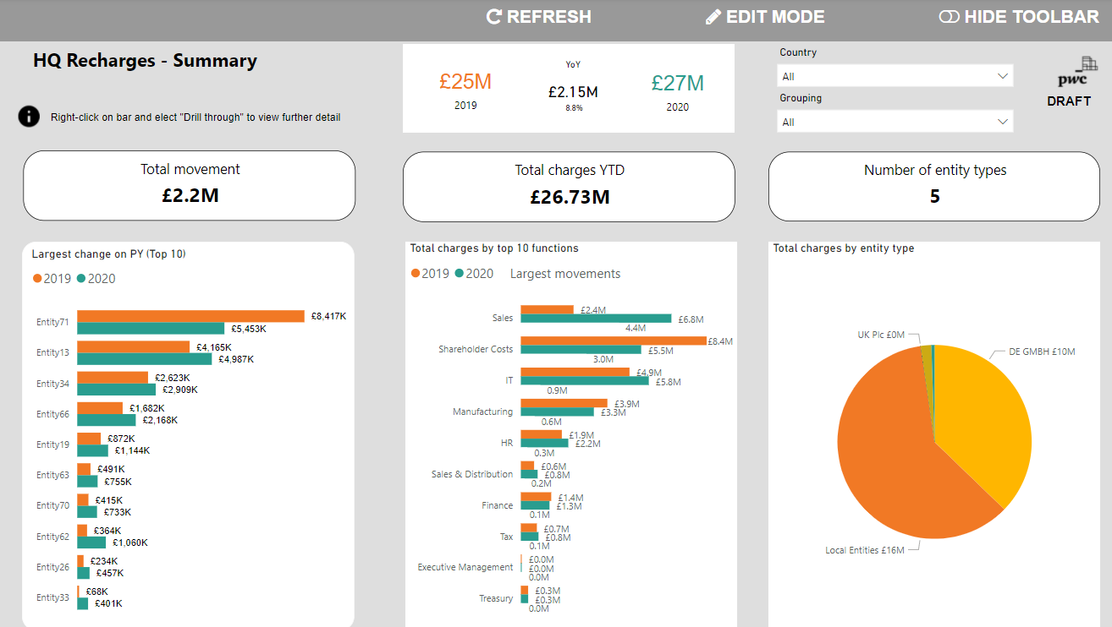
Headquarter recharges visualisation demo
Introduction┃Contents┃Business Development┃Propose┃Deliver┃Other
 | The Challenge Helping clients visualise and analyse their intercompany headquarter recharges.
 | Our Solution A tool that allows you to visualise and drill down into the transfer pricing recharges between group entities.
 | Available Insights Value of recharges Type of recharges Period on period change in recharge values Actual Vs budget recharges Recharge values by functions Flow of transactions between entities Analysis by territory
 | Pricing XYZ
 | Contact a.debenedictis@pwc.com colin.k.robertson@pwc.com lucy.cox@pwc.com |  | Important links Link to headquarter recharges visualisation demo
Data Driven
Tailored
Auditable
Client facing
OPTP

Slide 60
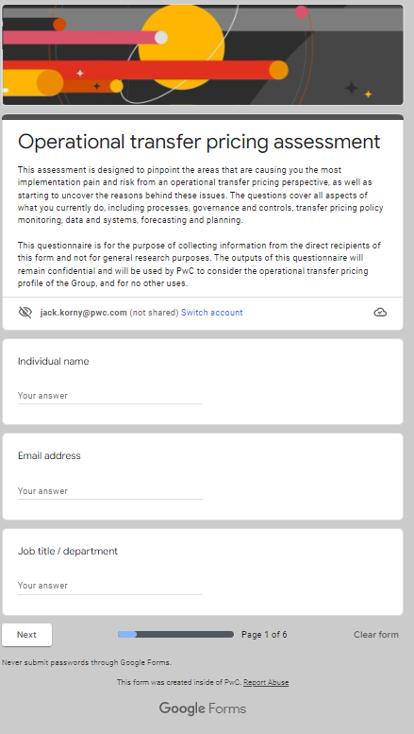
Operational TP Health Check tool
Introduction┃Contents┃Business Development┃Propose┃Deliver┃Other
 | The Challenge Identifying and articulating the risks, opportunities and challenges of implementing a client’s Transfer Pricing policies.
 | Our Solution A BD tool and a conversation starter to get clients engaged in Operational TP follow up discussions.
 | Guidance The assessment is designed to pinpoint the areas that are causing your clients the most implementation pain and risk from an operational transfer pricing perspective, as well as starting to uncover the reasons behind these issues. The questions in the tool cover all aspects of what your client currently does, including processes, governance and controls, transfer pricing policy monitoring, data and systems, forecasting and planning.
 | Pricing To be agreed with contacts below.
 | Contact colin.k.robertson@pwc.com lucy.cox@pwc.com |  | Important links Op TP Health Check tool
Rich Client Discussion
Proactive
Tailored
Client facing
OPTP

Slide 61
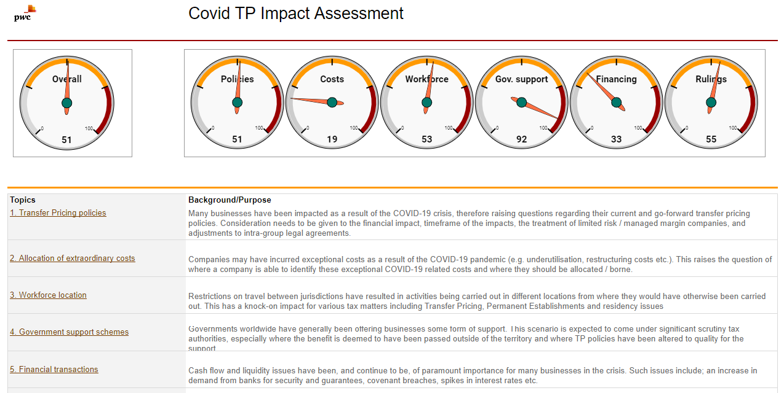
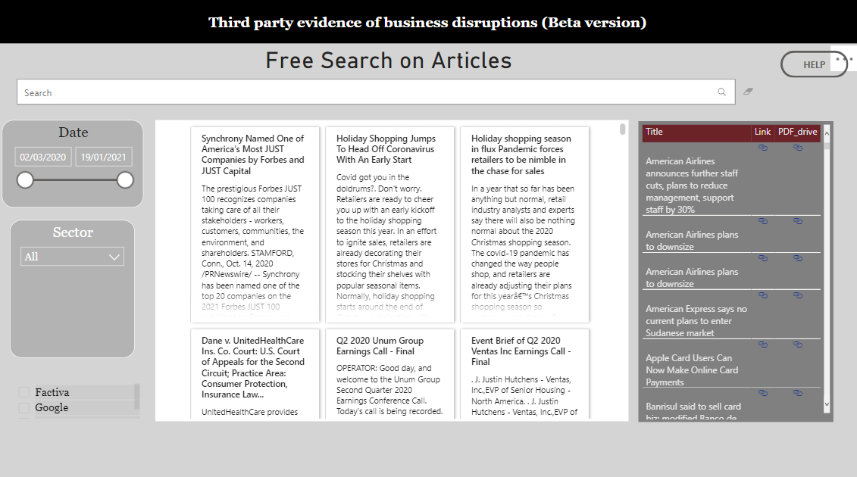
Covid impact related tools
Introduction┃Contents┃Business Development┃Propose┃Deliver┃Other
 | The Challenge Identifying and managing the TP impacts resulting from the COVID-19 pandemic.
 | Our Solutions Solution 1- Impact assessment A tool that can be used with your clients to undertake a high-level assessment of the TP impact from COVID-19 in order to identify priority areas of focus and facilitate a rich client discussion. This tool provides a) a process to step through the key risk areas with clients and b) something tangible we can send to them which they can share internally to show how the various areas have been addressed/considered |  |  |  | Solution 2- Evidence of Covid disruption This tool provides a collection of online media evidence of business disruptions and other actions related to the COVID-19 pandemic.
 | Guidance & training Solution 1- Impact assessment Guidance for using the Covid impact assessment tool |  |  |  | Solution 2- Evidence of Covid disruption Guidance for using third party Covid disruption evidence tool
 | Pricing Solution 1- Impact assessment Typically free of charge if likelihood of future work, otherwise a small time & expenses fee. |  |  |  | Solution 2- Evidence of Covid disruption N/A
 | Contact A member of the Central TP team |  | Important links Solution 1- Impact assessment Link to Covid impact assessment tool Link to auto generated general Covid client email Link to client flyer Contact a member of the Central TP team for further details. |  | Solution 2- Evidence of Covid disruption Third party Covid disruption evidence tool
Rich Client Discussion
Proactive
Add-on
Client facing
I&A

Slide 62
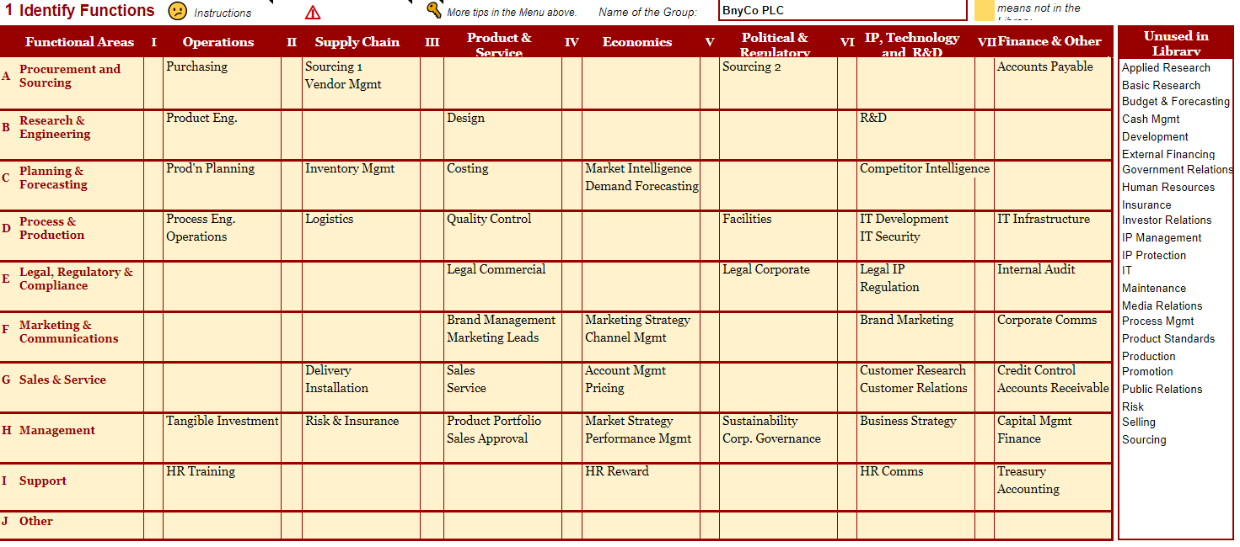
Function & risk analysis tool
Introduction┃Contents┃Business Development┃Propose┃Deliver┃Other
 | The Challenge Conducting a functional analysis in a structured format.
 | Our Solution The function & risk analysis tool.
 | Guidance & training Link to FAR training video
 | Contact andrew.j.casley@pwc.com |  | Important links FAR launch point
Time saver
Easy to use
Template
Internal
Doc

Slide 63

Tax Bot
Introduction┃Contents┃Business Development┃Propose┃Deliver┃Other
 | The Challenge Finding resources for technical research
 | Our Solution A research tool to find the resources available to you when undertaking technical research and learning more about a specific topic. It can share links to the basic and background information you might need, such as: General info & legislation - Croner-i HM Revenue & Customs manuals - HMRC manual site PwC technical papers Client material eg flyers etc if available, PwC Suite insights, links to tech tools to help with client work eg report generators Subject matter experts ie Network leader & NSL contact information
 | How to use it Tax bot can be found in Google Chat by searching for Tax Bot and is called Tax Bot_UK. It can be communicated with in the same way as a regular conversation with a colleague. If you type 'suggestion' into the Tax Bot search bar, you can suggest topics and report broken links. Demo Video Hints and Tips
 | Contact sophie.a.hughes@pwc.com |  | Important links Tax Bot
Time saver
Easy to use
Efficient
Internal
IE&E

Slide 64
Thank you
© 2022 PwC. All rights reserved. Not for further distribution without the permission of PwC. “PwC” refers to the network of member firms of PricewaterhouseCoopers International Limited (PwCIL), or, as the context requires, individual member firms of the PwC network. Each member firm is a separate legal entity and does not act as agent of PwCIL or any other member firm. PwCIL does not provide any services to clients. PwCIL is not responsible or liable for the acts or omissions of any of its member firms nor can it control the exercise of their professional judgment or bind them in any way. No member firm is responsible or liable for the acts or omissions of any other member firm nor can it control the exercise of another member firm’s professional judgment or bind another member firm or PwCIL in any way.

